Slide 1


Using TEI to encode the Academy of Sciences Portuguese Dictionary
Ana de Castro Salgado
NOVA, CLUNL
Lisbon, Portugal

Slide 2
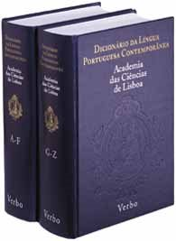
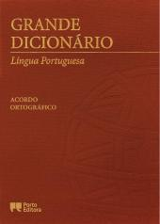

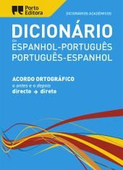

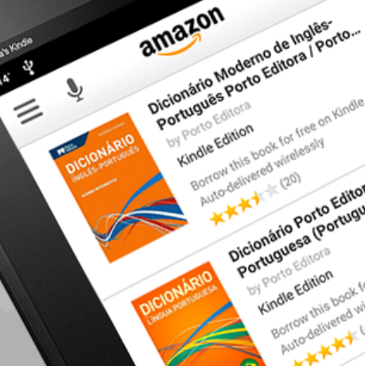


Who am I?
Lexicographer
PhD student (NOVA, CLUNL)
ELEXIS Travel Grant: Real Academia Española
11-30 November 2018 (Spain)
UNDER REVISION
TERMINOLOGY
LEXICOGRAPHY

Slide 3

2001 1st Academy of Sciences Portuguese Dictionary complete
Dicionário da Língua Portuguesa Contemporânea (DLPC)

Slide 4
2015 Portuguese academy wants a new dictionary
Academic proposal: expanding and updating the nomenclature in a Word document.
Proposal: content available in a digital format.
Team (Protocol with UMinho)
  Alberto Simões (2Ai Lab/IPCA, Algoritmi/UMinho, Galabra/UMinho)
  José João Almeida (Algoritmi, UMinho)
  Ana Salgado (ACL, NOVA CLUNL)
  Álvaro Iriarte Sanromán (Galabra/UMinho)
Non-funded project

Slide 5
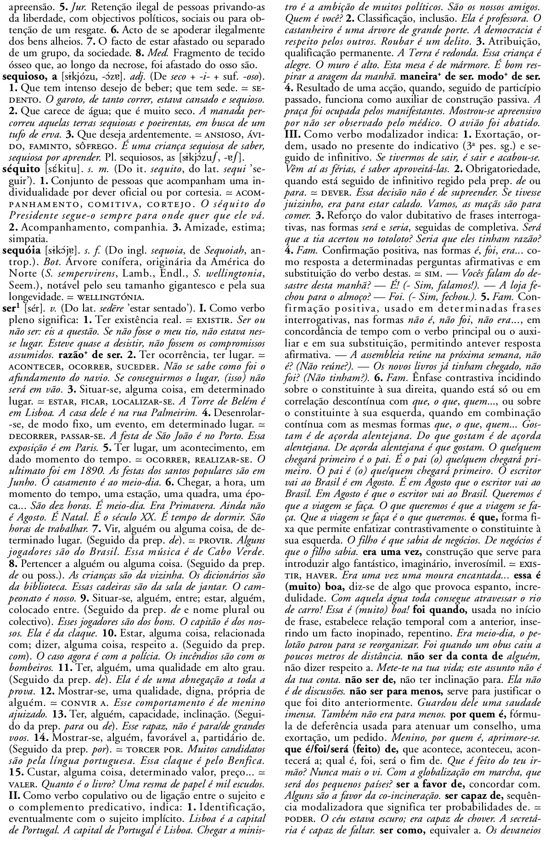
A single PDF!
*
3809 pages!
Simple entries
COMPLEXITY
Notes:
rápida

Slide 6
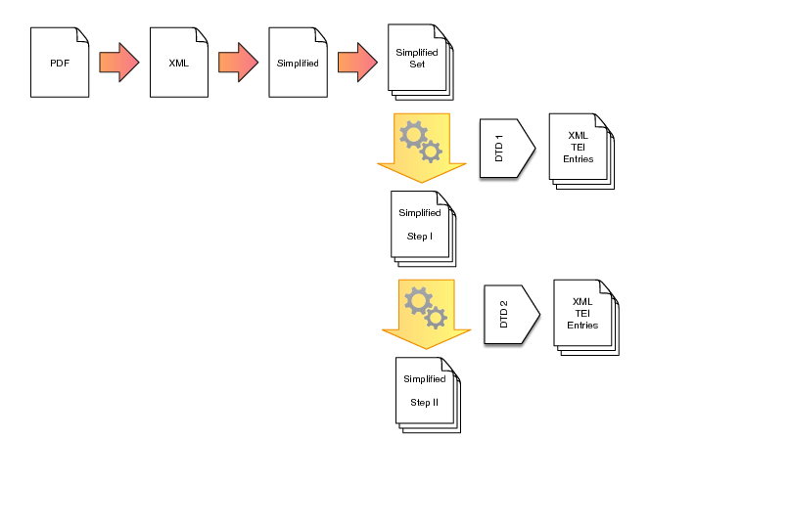

Convert to XML
By Alberto Simões

Slide 7

XML result
XML editor?
<entry xmlns:m="http:/Math/MathML“ xmlns:vc="http://www.w3.org/2007/XMLSchema-versioning" xmlns:xsi="http://www.w3.org/2001/XMLSchema-instance" xsi:noNamespaceSchemaLocation="http://per-fide.di.uminho.pt:8080/exist/rest/db/schemas/academia-new.xsd">
<meta status="imported"/>
<term>/www.w3.org/1998/
<orth>vassoura</orth> <orth>vassoira</orth>
<pron>vɐsˈorɐ</pron> <pron>vɐsˈojrɐ</pron> </term>
<group> <gramGrp>n. f.</gramGrp>
<sense n="1"> <def> Utensílio doméstico formado por um cabo longo ou curto ao qual é fixado, numa das extremidades, um feixe de folhas de palma, piaçaba, sorgo, pêlos naturais ou artificiais... e que serve para varrer o lixo. </def> […]
How to allow editing by lexicographers: directly in XML?
Using !
TEI Guidelines for the representation of lexical information, with a syntax adapted to our needs
Notes:
muito rápida

Slide 8

Why am I here?
To adapt the Academy Dictionary into
TEI Lex-0
To deepen my knowledge in managing digital data as online resources
To improve my competences in XML editors
How did I notice it?
July 2018
Seminar in NOVA Lisbon Summer School – «From print to screen: the theory and practice of digitizing Dictionaries» (T. Tasovac)

Slide 9
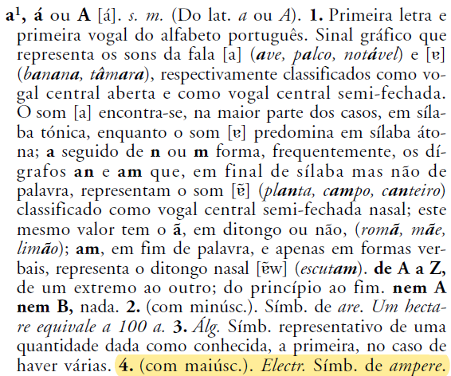
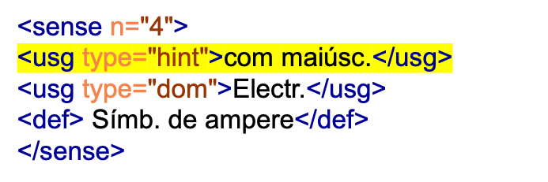
TEI: incorrect specification element
Other elements, <cit>, <quote>…

Slide 10
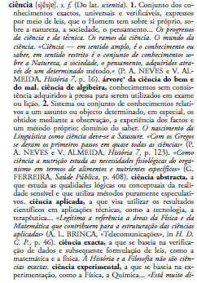

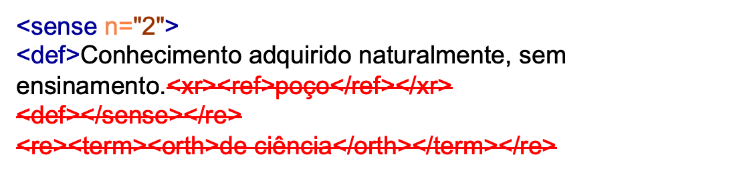
TEI: lexical co-occurrents
How to encode this information?

Slide 11
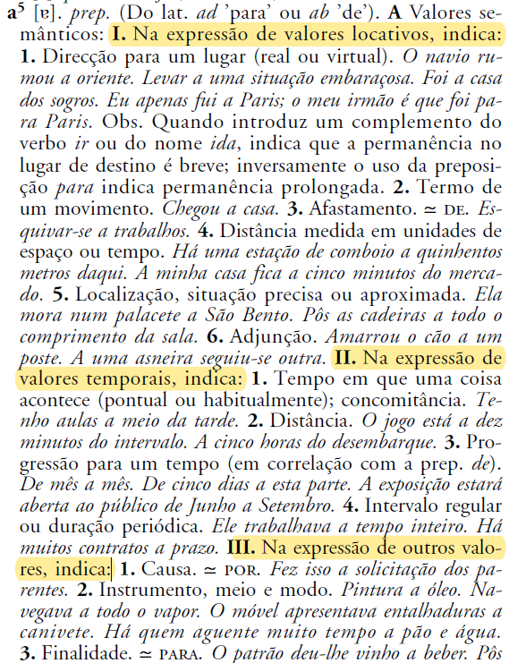
TEI: grammatical information
PREPOSITIONS
How to encode this information?

Slide 12
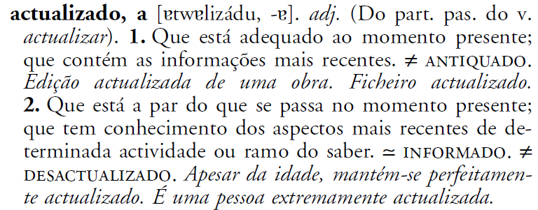
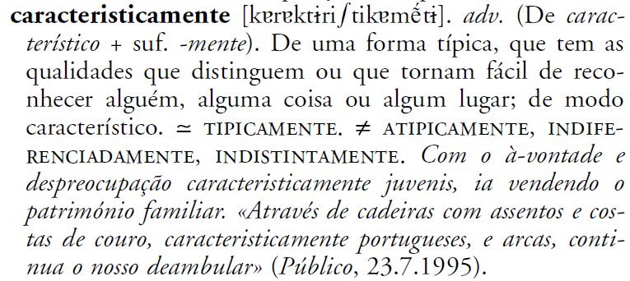
TEI: The Portuguese Spelling Reform
OA90
atualizado
OA90
caracteristicamente, carateristicamente
OA90 =
Ortographic Agreement of 1990,
Community of Portuguese Speaking Countries (CPLP)

Slide 13
I'm very excited for being here… and I am really motivated to work hard and improve Portuguese lexicographical work. I'm looking forward to be working with you all! ☺
Ana de Castro Salgado
NOVA, CLUNL
Lisbon, Portugal
anasalgado@campus.fcsh.unl.pt
anacastrosalgado@gmail.com
https://www.linkedin.com/in/ana-salgado-870927/
https://twitter.com/acastrosalgado
https://www.facebook.com/anacastrosalgado
https://www.porticodalinguaportuguesa.pt

